Slide 1
HELLO
we are
Immigration Nation
wesley hughes + katie roshelli + cody turner + mallory wynn + ying yao
*All images stolen from Flickr and Google image search
Notes:
hi, we are Immigration Nation. there are five of us (introduce everyone), not the biggest nation but
as the title suggests, our info viz is focused on the topic of immigration

Slide 2

Project Motivations
personal ties
unbiased approach
historical events that affect immigration trends
Notes:
we all had a personal investment to the topic(involvement with other cultures or from an immigrant), everyone can relate
as we learned in class, data is easily manipulated to present a certain view, so we wanted to convey the data we found without any bias
data without context has little meaning so we wanted to correlate any anomalies in the data with historical events that happened at the same time

Slide 3
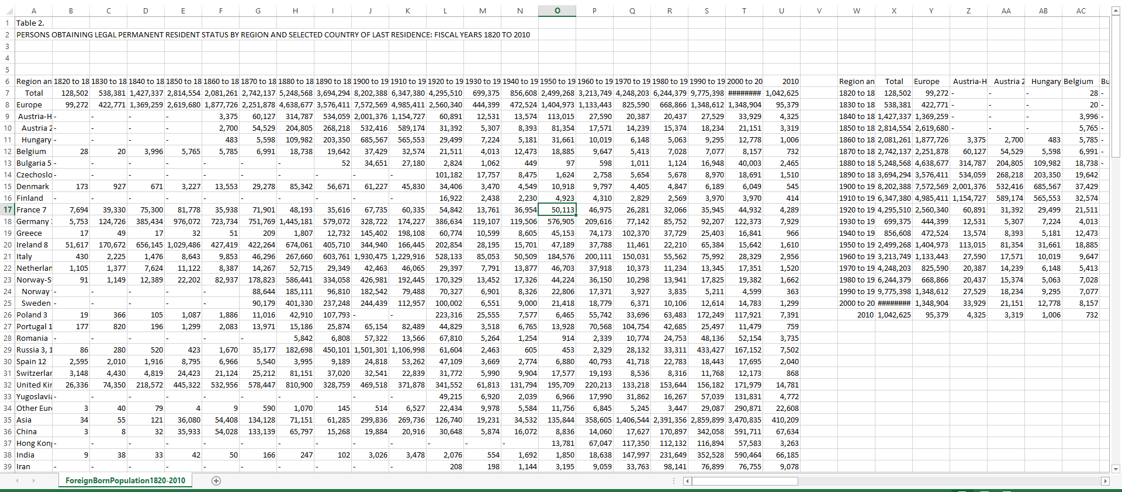
The Data
Notes:
What is our data? Where/How did we get it?
This is the data in its original spreadsheet form (pretty intimidating)
this data is publically accessible, but difficult for anyone to consume
very low pre-attentive processing, requires user to actively read through the numbers and even then…
numbers by themselves mean little to the audience without comparison and context
historical data spreadsheet looks similar to this

Slide 4

Design
Notes:
The next step was to design our visualization (Mallory)
first and foremost, we wanted to keep the end users in mind to create a relevant vis
we wanted to display all of the immigration data in a way that people could quickly understand and interact with
we also wanted to make sure we provided context in three distinct levels
context of immigration over time
geospatial context in terms of visualizing a map
context of historical events that might have affected immigration during a certain period of time
balance geographical, text, numerical data
consistent color palette across all three visualizations
size based off of “importance”

Slide 5

Development
Notes:
Development
NotePad++/Sublime Text
Lightweight, easy
Google Chrome/Developer Tools for debugging
D3
datamaps.github.io
Great for our project
Poorly documented
difficult to manipulate, no API
required too much hard coding
Not extensible

Slide 6
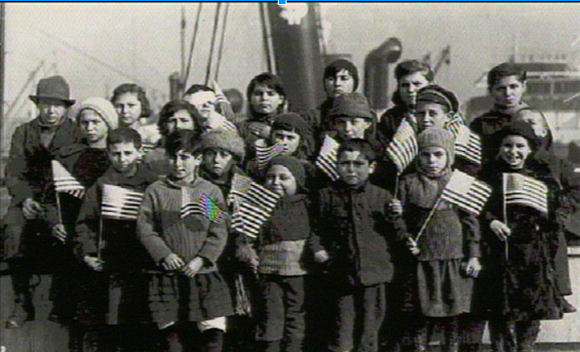
Demo
User Questions
+
Notes:
with that in mind, here is our visualization
Explain the difference between the map and the area visualization (aggregate sums of immigrants over total timespan vs. immigrants shown in ten year intervals)
The overall map and area chart are great for a preattentive glance at the data, you can quickly gauge which regions have immigrated most and when
The map is great contextually to see where immigrants are coming from/ raise questions about how geographical location might also affect immigration
Rise of ocean liner
Explain the tool tips/ details on demand
Different formmating for both bubbles and area chart b/c of differences in purpose.
Use of lines to help user better gauge the area chart especially because baseline can be hard
Explain ability to drill down
Linked views of map and area chart
(mention resizing of y axis)
Allows the viewer to explore the composition of immigrants
Explain historical events
Explain context/ focus bar
Mention what we would like to continue to improve upon
if we had more time, features we would have liked to implement (Katie)
highlighting between bubbles and area map on countries
bubbles change size when we use brushing
better coloring scheme due to europe having 20 countries
Linking to wikipedia or other sources
Filter for specific historical events
allow for illegal immigration statistics to be displayed
user questions/demo of abilities: (Katie)
What continent has the largest amount of immigration into the US?
Look at map and use aggregate bubbles to answer.
How have immigration trends changed over the last 200 years?
Can see that initial large wave of immigrants actually comes from a more developed country to a less developed country. Immigrants seeking freedom, a chance at a new life.
overseas
Second wave is actually from poorer, underdeveloped countries to more developed countries. Also, more immigration from asia than ever before (could have to do with repeal of chinese exclusion act)
What countries have had the biggest impact on immigration/ is there really a difference in the current immigration from Mexico to the united states/ what caused the flood of Mexican immigrants?
Look at causes of flood of Mexican immigrants.... combination of economic issues in Mexico alongside the bracero program which invited Mexican laborers into the states.
One difference is that Mexican immigration composes a much larger percentage of its region’s immigrants. (look at composition of european immigration at its peak vs. Mexican immigration at that time.
Also, we can use the map to see how it’s geographical location has affected its immigration: it is the longest border of a third world country with a first world country
What impact does war or economic distress/ abundance have on immigration?
Look at both world wars/ stock market crash, gold rush, cuban revolution

Slide 7

Team Roles
Notes:
Group Breakdown
Wesley Hughes
US Map
Ying Yao
History/Data collection
Katie Roshelli
Stacked Graph, zoom/update features
Cody Turner
History/Data collection
Mallory Wynn
Project Management
Design
History/Data Collection

Slide 8

Lessons
Learned
Notes:
D3 is amazing
Somewhat easy to use
able to quickly and smoothly render data visualizations
extended libraries which allow for greater customization
color schemes are a hard topic to apply correctly
also, spatial layout of visualization and information is important
Data collection is hard
Pulling data from direct source still left large gaps
Color scheme is important
Immigration is important to everyone
Lines became blurred as we realized how influential immigration was on the native population

